Slide 1

Cardiovascular Disease Prediction
Group: 32
Presentation By:
Arnav Gupta
Karan Gupta
Shivesh Gulati
Vishal Singh
2021236
2021258
2021286
2021575

Slide 2


Outline
Introduction
Motivation
Literature Review
Dataset Description
Models and Methodologies
Result Analysis and Conclusion
Timeline
Contributions

Slide 3

Outline
Introduction
Motivation
Literature Review
Dataset Description
Models and Methodologies
Result Analysis and Conclusion
Timeline
Contributions

Slide 4
Shape, Size and Derived Features
The dataset used for this study was obtained from Kaggle and had 70,000 rows and 13 columns originally
The first column, is the patient ID, which has been dropped
2 Derived features were added to the dataset based on the insights gathered from the Research Paper-2:

Slide 5
 | WHAT IS YOUR CONCEPT ABOUT? |  | HOW ARE YOU GOING TO SHOWCASE IT? | ADDITIONAL NOTES
WRITE CONCEPT 2
WRITE CONCEPT 3
WRITE CONCEPT 4
Use this table to present an organized summary of your concepts.

Slide 6

Feature
Monday
Tuesday
Wednesday
Thursday
Friday
Accomplishments:
To-Do's:
Blockers:
Accomplishments:
To-Do's:
Blockers:
Accomplishments:
To-Do's:
Blockers:
Tara
Accomplishments:
To-Do's:
Blockers:
Accomplishments:
To-Do's:
Blockers:
Accomplishments:
To-Do's:
Blockers:
Accomplishments:
To-Do's:
Blockers:
Accomplishments:
To-Do's:
Blockers:
Accomplishments:
To-Do's:
Blockers:
Accomplishments:
To-Do's:
Blockers:
Sky
Accomplishments:
To-Do's:
Blockers:
Accomplishments:
To-Do's:
Blockers:
Accomplishments:
To-Do's:
Blockers:
Accomplishments:
To-Do's:
Blockers:
Accomplishments:
To-Do's:
Blockers:
Rain
Accomplishments:
To-Do's:
Blockers:
Accomplishments:
To-Do's:
Blockers:
Accomplishments:
To-Do's:
Blockers:
Accomplishments:
To-Do's:
Blockers:
Accomplishments:
To-Do's:
Blockers:
Silas

Slide 7
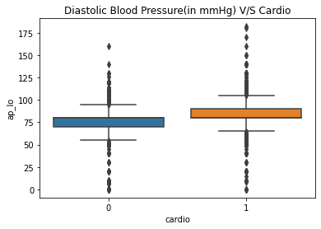
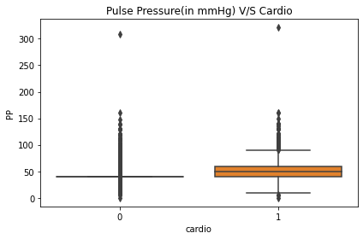
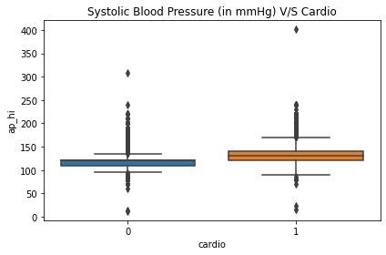
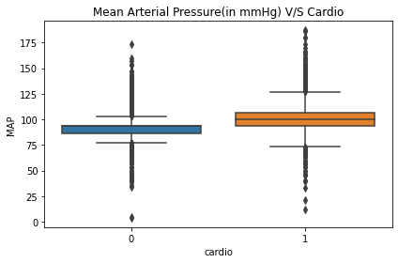
Box Plots

Slide 8
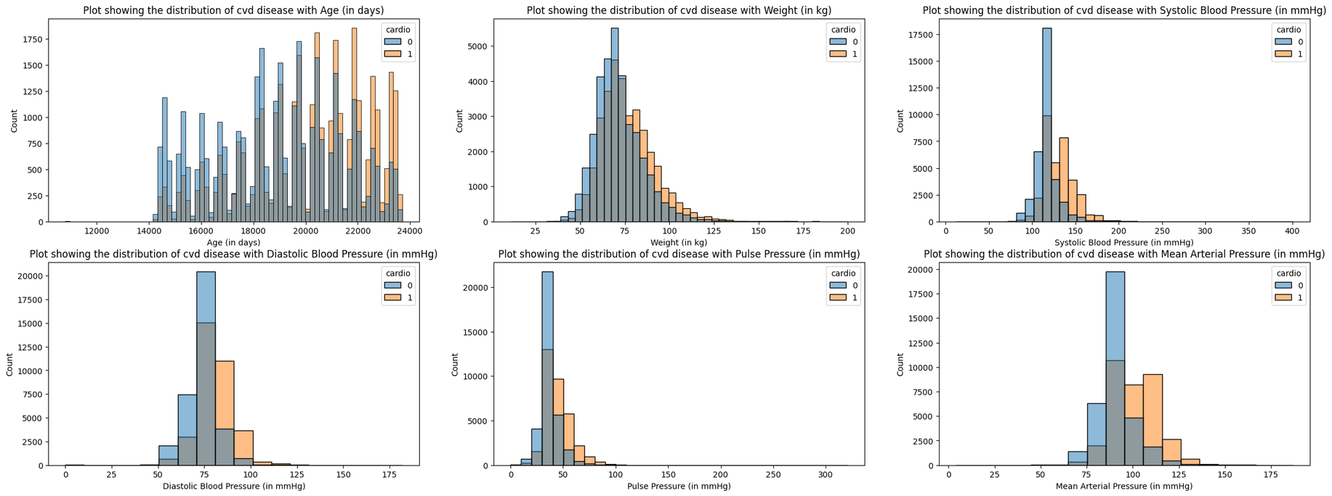
Histograms
How i applu that arrow?

Slide 9
L
R
</>

Slide 11
Dataset Description

Slide 12
Feature Extraction
Manual CAP
For the original and derived features of Blood Pressure, Values not in the range [0,500] were manually dropped.
Outlier Detection and Cleaning
Z-Score
70,000
68,727
Applied Z-Score on the Manually Capped Data
68,727
68,727
LOF
Applied Local Outlier Factor on the Manually Capped Data
68,727
54,981

Slide 13
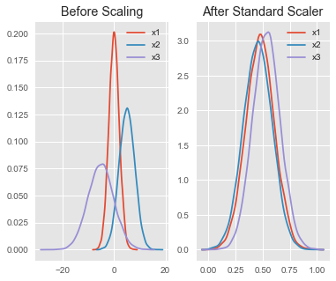
Feature Extraction
Data Standardization

Slide 14
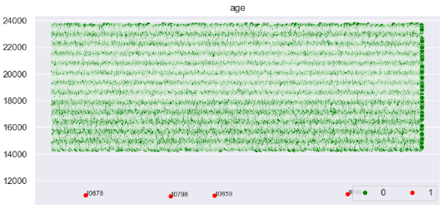
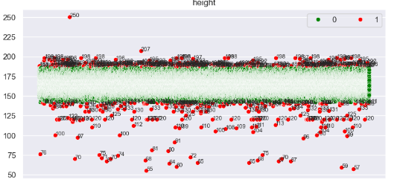
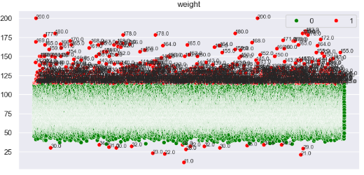
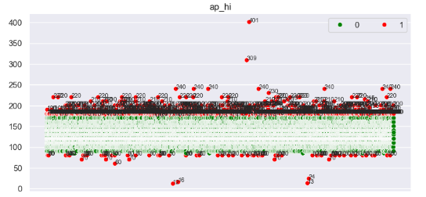
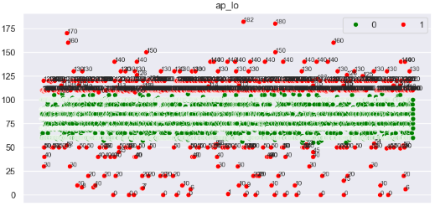
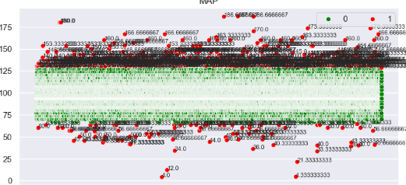
Z-Score

Slide 15
Outline
Introduction
Motivation
Literature Review
Dataset Description
Models and Methodologies
Result Analysis and Conclusion
Timeline
Contributions

Slide 16

Models and Methodologies
Classification Problem
Naive Bayes Classifier
Logistic Regression Classifier
Support Vector Machine

Slide 17
Models (Stats)
LOF
Z-Score
0.75
Naive Bayes
LOF Data
Standard Data
One Hot Encoded Data
One Hot + PCA Data
0.5
0.25
Z-Score Data
Standard Data
One Hot Encoded Data
One Hot + PCA Data
0
Stand.
One Hot
PCA
Accuracy

Slide 18
Models (Stats)
LOF
Z-Score
0.75
Logistic Regression
LOF Data
Standard Data
One Hot Encoded Data
One Hot + PCA Data
0.5
0.25
Z-Score Data
Standard Data
One Hot Encoded Data
One Hot + PCA Data
0
Stand.
One Hot
PCA
Accuracy

Slide 19
Models (Stats)
LOF
Z-Score
0.75
Support Vector Machine
LOF Data
Standard Data
One Hot Encoded Data
One Hot + PCA Data
0.5
0.25
Z-Score Data
Standard Data
One Hot Encoded Data
One Hot + PCA Data
0
Stand.
One Hot
PCA
Accuracy

Slide 20
Models (Stats)
Accuracy
Precision
Recall
F1-Score
Model | Accuracy | Precision | Recall | F1-Score
Naive Bayes | 0.7313731433767808 | 0.7889288281811646 | 0.6493491124260355 | 0.7123661148977606
Logistic | 0.7371324643831464 | 0.6914792899408284 | 0.7716587427363972 | 0.7293721133441518
SVM | 0.7392543194907548 | 0.6900591715976331 | 0.776121389591375 | 0.7305644302449413
3
2
1
0
Naive Bayes
Logistic
SVM

